Slide 1
Interfaces and delegates
Chapter - 11

Slide 2
interfaces

Slide 3
What is an interface
An interface consists of a set of signatures for one or more methods, properties, indexers, or events.
An interface doesn't provide an implementation for any of its members.
Instead, it indicates what members must be defined by any class that implements the interface.
By convention, interface names begin with the letter I to distinguish them from classes.
To implement an interface, a class must name the interface on the class declaration, and it must provide an implementation for every member of the interface.

Slide 4
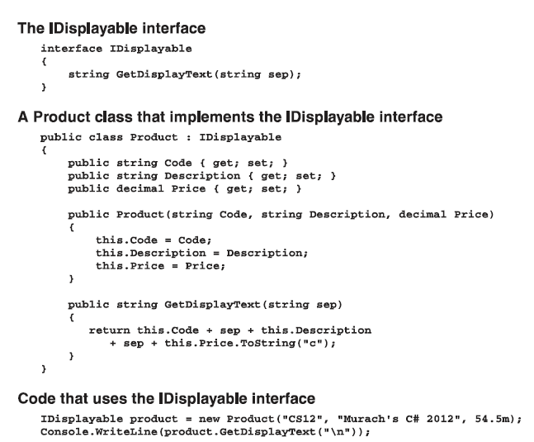

Slide 5
Explanation of code
The examples in the previous slide show how a simple interface is declared and implemented by a class.
The first example shows the declaration for a custom interface named IDisplayable. This Interface includes a single method named GetDisplayText that allows an Object to return a string that can be used to display the Object. Any class that implements the IDisplayable interface must provide an implementation of the GctDisplayText method.
The second example shows a simplified version of a Product class that implements the IDisplayable interface. Here, you can see that the class statement for the Product class lists IDisplayable as an interface that's implemented by the class. Then, the class provides an implementation of the GetDisplayText method that returns a string that contains all three properties of the Product class.
The third example shows that a Product object that implements the IDisplayable interface can be stored in a variable of the IDisplayable type. In other words, an object created from a Product class that implements the IDisplayable interface is both a Product object and an IDisplayable object. As a result, you can use this object anywhere an IDisplayable object is expected.
Notes:
http://www.advancesharp.com/blog/1094/interface-in-c-with-real-time-example

Slide 6
Need for interfaces
In some object-oriented programming languages, such as C++ and Perl, a class can inherit more than one class. This is known as multiple inheritance.
In C#, however, a class can inherit only one class.
Although C# doesn't support multiple inheritance, it does support a special type of coding element known as an interface.
An interface provides many of the advantages of multiple inheritance without some of the problems that are associated with it.

Slide 7
A comparison of interfaces and abstract classes
Both interfaces and abstract classes provide signatures for properties and methods that a class must implement.
All of the members of an interface are abstract. In contrast, an abstract class can implement some or all of its members.
A class can inherit only one class (including abstract classes), but a class can implement more than one interface.
Interfaces can 't declare static members, but abstract classes can.

Slide 8
delegates
Notes:
This chapter is excerpted from Learning C# 3.0: Master the fundamentals of C# 3.0 by Jesse Liberty, Brian MacDonald, published by O'Reilly Media
https://www.tutorialsteacher.com/csharp/csharp-delegates

Slide 9
What is a Delegate
A function can have one or more parameters of different data types, but what if you want to pass a function itself as a parameter?
How does C# handle the event handler?
The answer is - delegate.
A delegate is a reference type, but instead of referring to an object, a delegate refers to a method.
This is called encapsulating the method.
When you create the delegate, you specify a method signature and return type; you can encapsulate any matching method with that delegate.

Slide 10
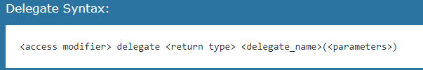
Declaring a delegate
You create a delegate with the delegate keyword, followed by a return type and the signature of the methods that can be delegated to it, as in the following:
public delegate int FindResult(object obj1, object obj2);
This declaration defines a delegate named FindResult, which will encapsulate any method that takes two objects as parameters and that returns an int.
Once the delegate is defined, you can encapsulate a member method with that delegate by creating an instance of the delegate, passing in a method that matches the return type and signature.
Notice that the delegate has no method body; that's because you're not defining the method here. You're simply saying that this delegate can encapsulate any method with the appropriate signature; you don't care what it does or how it does it, as long as it has the right parameters and returns the correct type.

Slide 11
Declaring a delegate
Delegates decouple the class that declares the delegate from the class that uses the delegate. The class that declares the delegate FindResult doesn't need to know how the result is found, or what class uses the delegate; all it needs to do is get an int back.
For example, suppose you have a class called MediaStorage that you use to store and manage various media files-audio files, video files, animation files; the type of file doesn't matter to the class. Suppose further that you want this class to be able to play the files to make sure they can be played successfully, and report on whether they played properly or not (as a way of testing whether the file is valid). The MediaStorage class doesn't need to know how to play the files; it just needs to receive a code indicating whether the file played successfully or not.

Slide 12
Delegate declaration
The delegate declaration in MediaStorage is rather simple:
public delegate int PlayMedia();
This delegate takes no parameters, but expects an int as a return value, to indicate whether the file played successfully.
A value of 0 indicates success; anything else indicates failure. Note again that the method has no body.

Slide 13
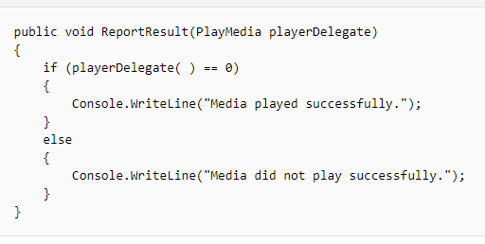
Delegate usage
The only other method in MediaStorage is ReportResult( ), which outputs to the console the result from the media test:

Slide 14
Delegate usage
This looks like a normal method, except for the parameter it takes: playerDelegate, which is not an int, as you might expect, but rather a delegate, of type PlayMedia, which you declared earlier. It's not easy to think of a method in the same terms that you might normally think of an object, but that's how delegates work.
In the body of the method, you can't declare playerDelegate directly as an integer, because playerDelegate is a reference to a method. Instead, you evaluate the method that the delegate points to, and compare the result. That's why you're testing playerDelegate()==0. From there, you just output an appropriate message.

Slide 15
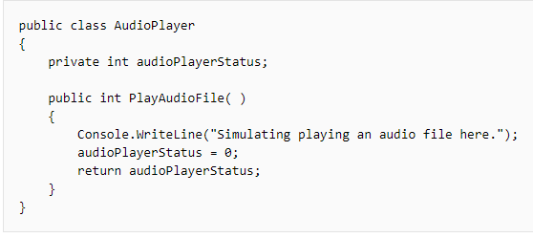
Delegate usage
Take a look now at one of the media player classes:
This class has one private member, and a simple public method that simulates playing an audio file and returning a status code in the form of an int. This method, PlayAudioFile( ), has the signature the delegate requires, so this method can be used with the delegate. (Of course, a real media player would have many more methods than just this one, but we're keeping things simple for testing purposes.)
The other media player class is VideoPlayer, with a similar PlayVideoFile( ) method.

Slide 16
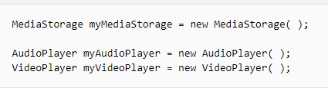
Instantiate the two media players
Within the body of the program, you first need to instantiate the MediaStorage class, and then one of each of the players:

Slide 17
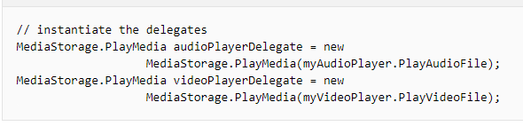
Instantiate the delegates
That's easy enough. The next thing you need to do is instantiate the delegates. The delegates are of the type MediaStorage.PlayMedia (note that you're using the MediaStorage class here, not the object of that class you created a minute ago). You still use the keyword new to instantiate the delegate, but you pass the method PlayAudioFile as a parameter to the delegate when it's created. The result is that audioPlayerDelegate is a delegate of type PlayMedia, which you can now work with as a reference to that method:

Slide 18

Call the delegates
Now that you have the two delegate instances, you use the delegates with the ReportResult( ) method to see whether the media files were valid. Notice here that what you're passing to the ReportResult( ) method is a reference to a method in a different class altogether:
The outcome of this is the first line causes ReportResult( ) to call the PlayAudioFile( ) method, but the second line causes it to call the PlayVideoFile( ) method. At compile time, ReportResult( ) doesn't know which method it is going to call-it finds out only when it is invoked at runtime. All it needs to know is that any method it will be asked to call will match the signature defined by the PlayMedia delegate.

Slide 19
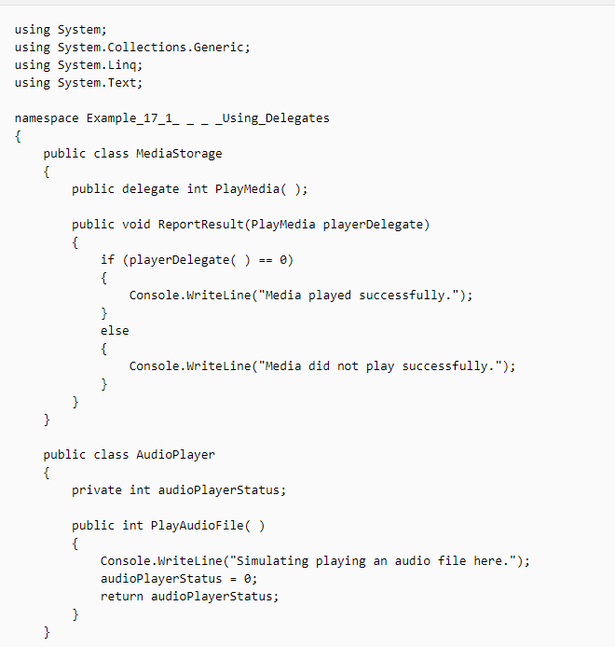
The Entire Program

Slide 20
